Slide 1



The Power of Great Datasets
Alex Cookson
@alexcookson
tacookson
Thank You Allison Horst for the amazing illustration

Slide 2
How do I learn how to do [thing] in R?

Slide 3
How do I learn how to do [thing] in R?
[ sentiment analysis ]
[ data visualization ]
[ web scraping ]
[ forecasting ]
[ … ]

Slide 4
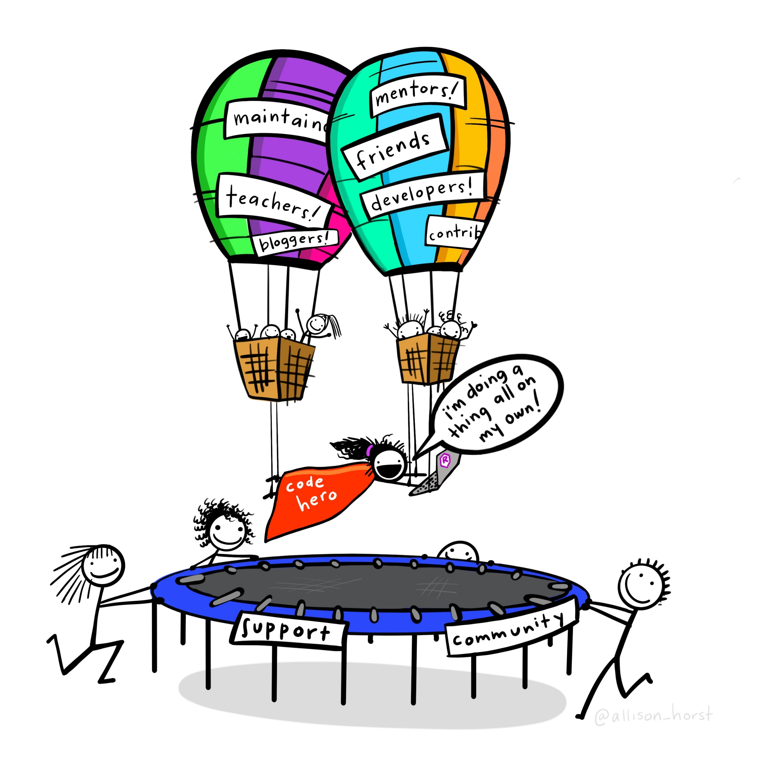
Artwork by @allison_horst

Slide 5
What about
Great Datasets are
?

Slide 6
Great Datasets are COOL

Slide 7
Great Datasets are COOL
and
INTERESTING

Slide 8
Great Datasets are COOL
and
INTERESTING

Slide 9
Great Datasets are COOL
and
INTERESTING
“That’s cool!”
Cool to me isn’t (necessarily) cool to you
Speaks to you on a deeper level

Slide 10
Great Datasets are COOL
and
INTERESTING

Slide 11
Great Datasets are COOL
and
INTERESTING
Prompts you to ask questions
Rouses your curiosity
“Just one more graph”

Slide 12
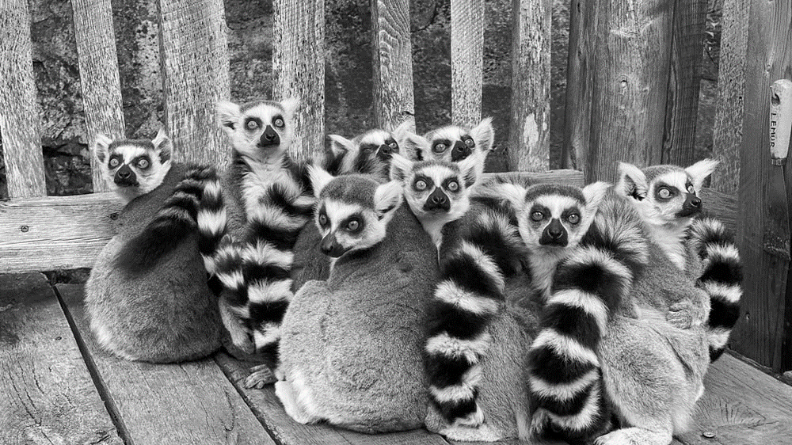
Duke Lemur Center
Ring-tailed Lemurs have an average weight of 2.2kg

Slide 13

Broadway Grosses
Hamilton holds the record for top ticket price on Broadway — $998

Slide 14
Fictional Character Personalities

Slide 15
Fictional Character Personalities

Slide 16
Fictional Character Personalities
Traits of 800 characters across 250+ spectrums

Slide 17
Fictional Character Personalities
Traits of 800 characters across 250+ spectrums
Playful
Serious

Slide 18

Fictional Character Personalities
Traits of 800 characters across 250+ spectrums
Michael Scott
(The Office)
Playful
Serious

Slide 19
Fictional Character Personalities
Traits of 800 characters across 250+ spectrums
Worf
(Star Trek: The Next Generation)
Michael Scott
(The Office)
Playful
Serious

Slide 20
What are some of my favourite characters’ personalities?

Slide 21
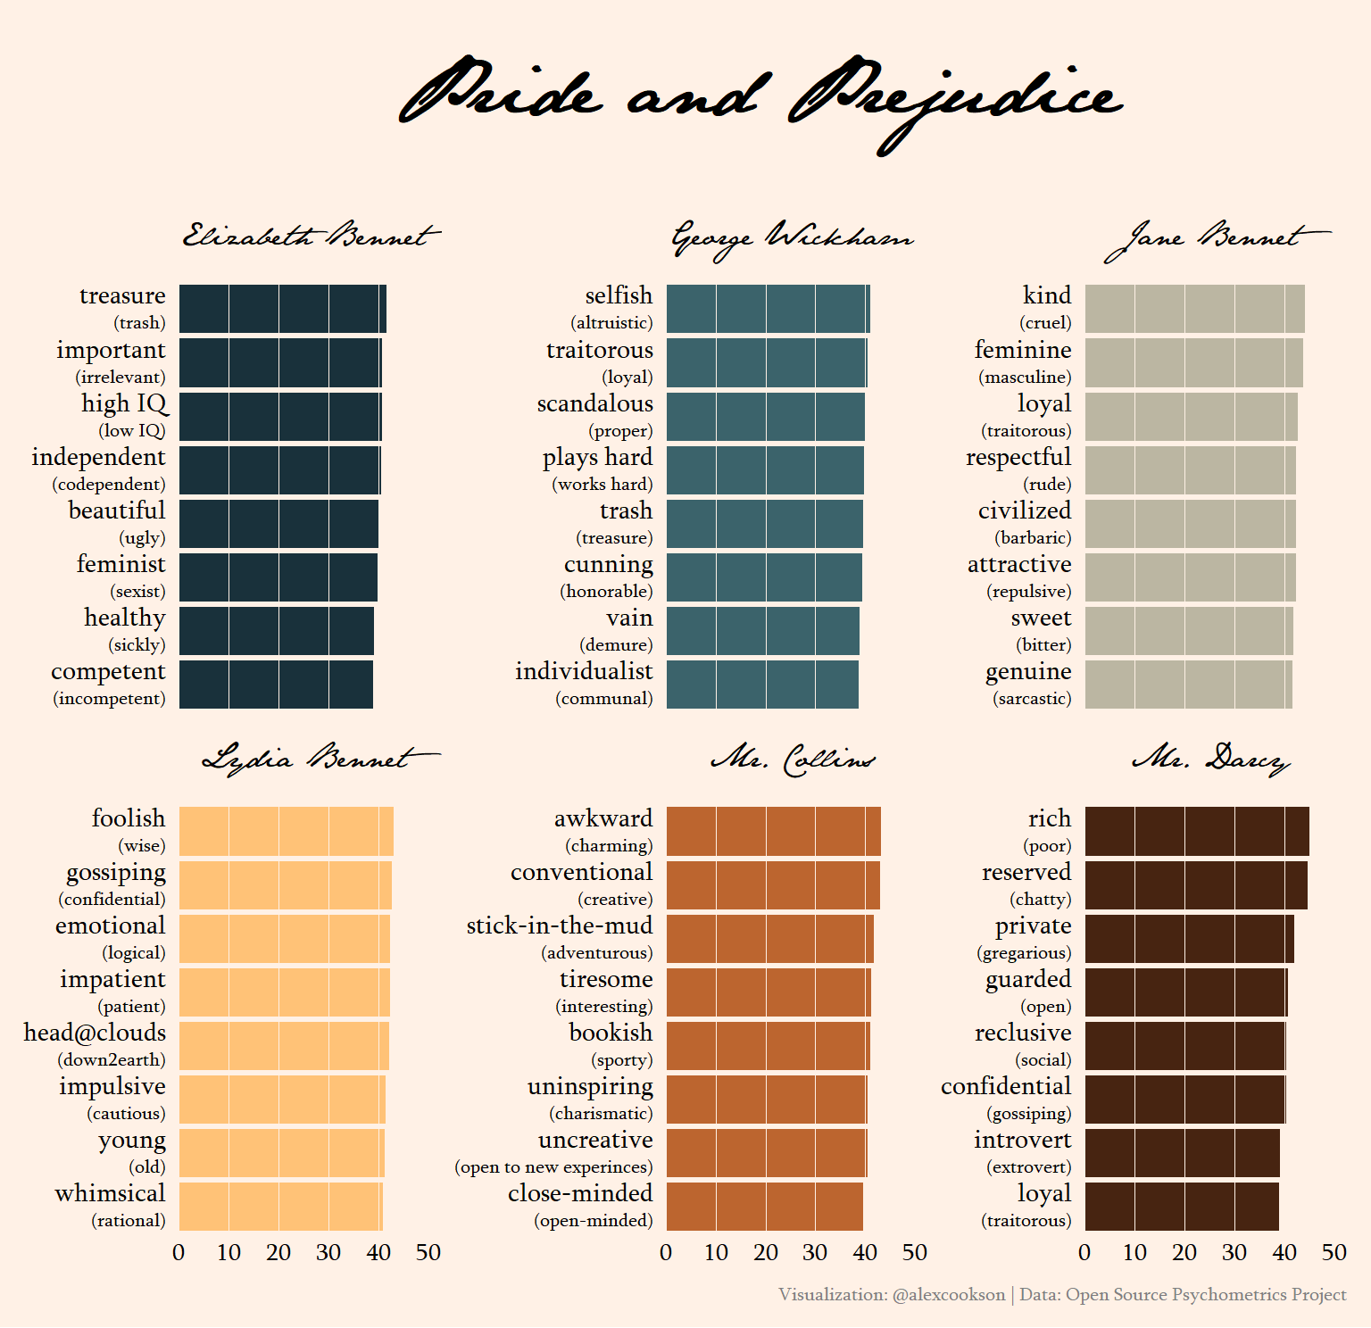

Slide 22
Use custom fonts
Tweak labels with {glue} and {ggtext}
Choose an appropriate colour palette
Adjust a LOT of theme() elements

Slide 23
Which characters are most similar to one another?

Slide 24
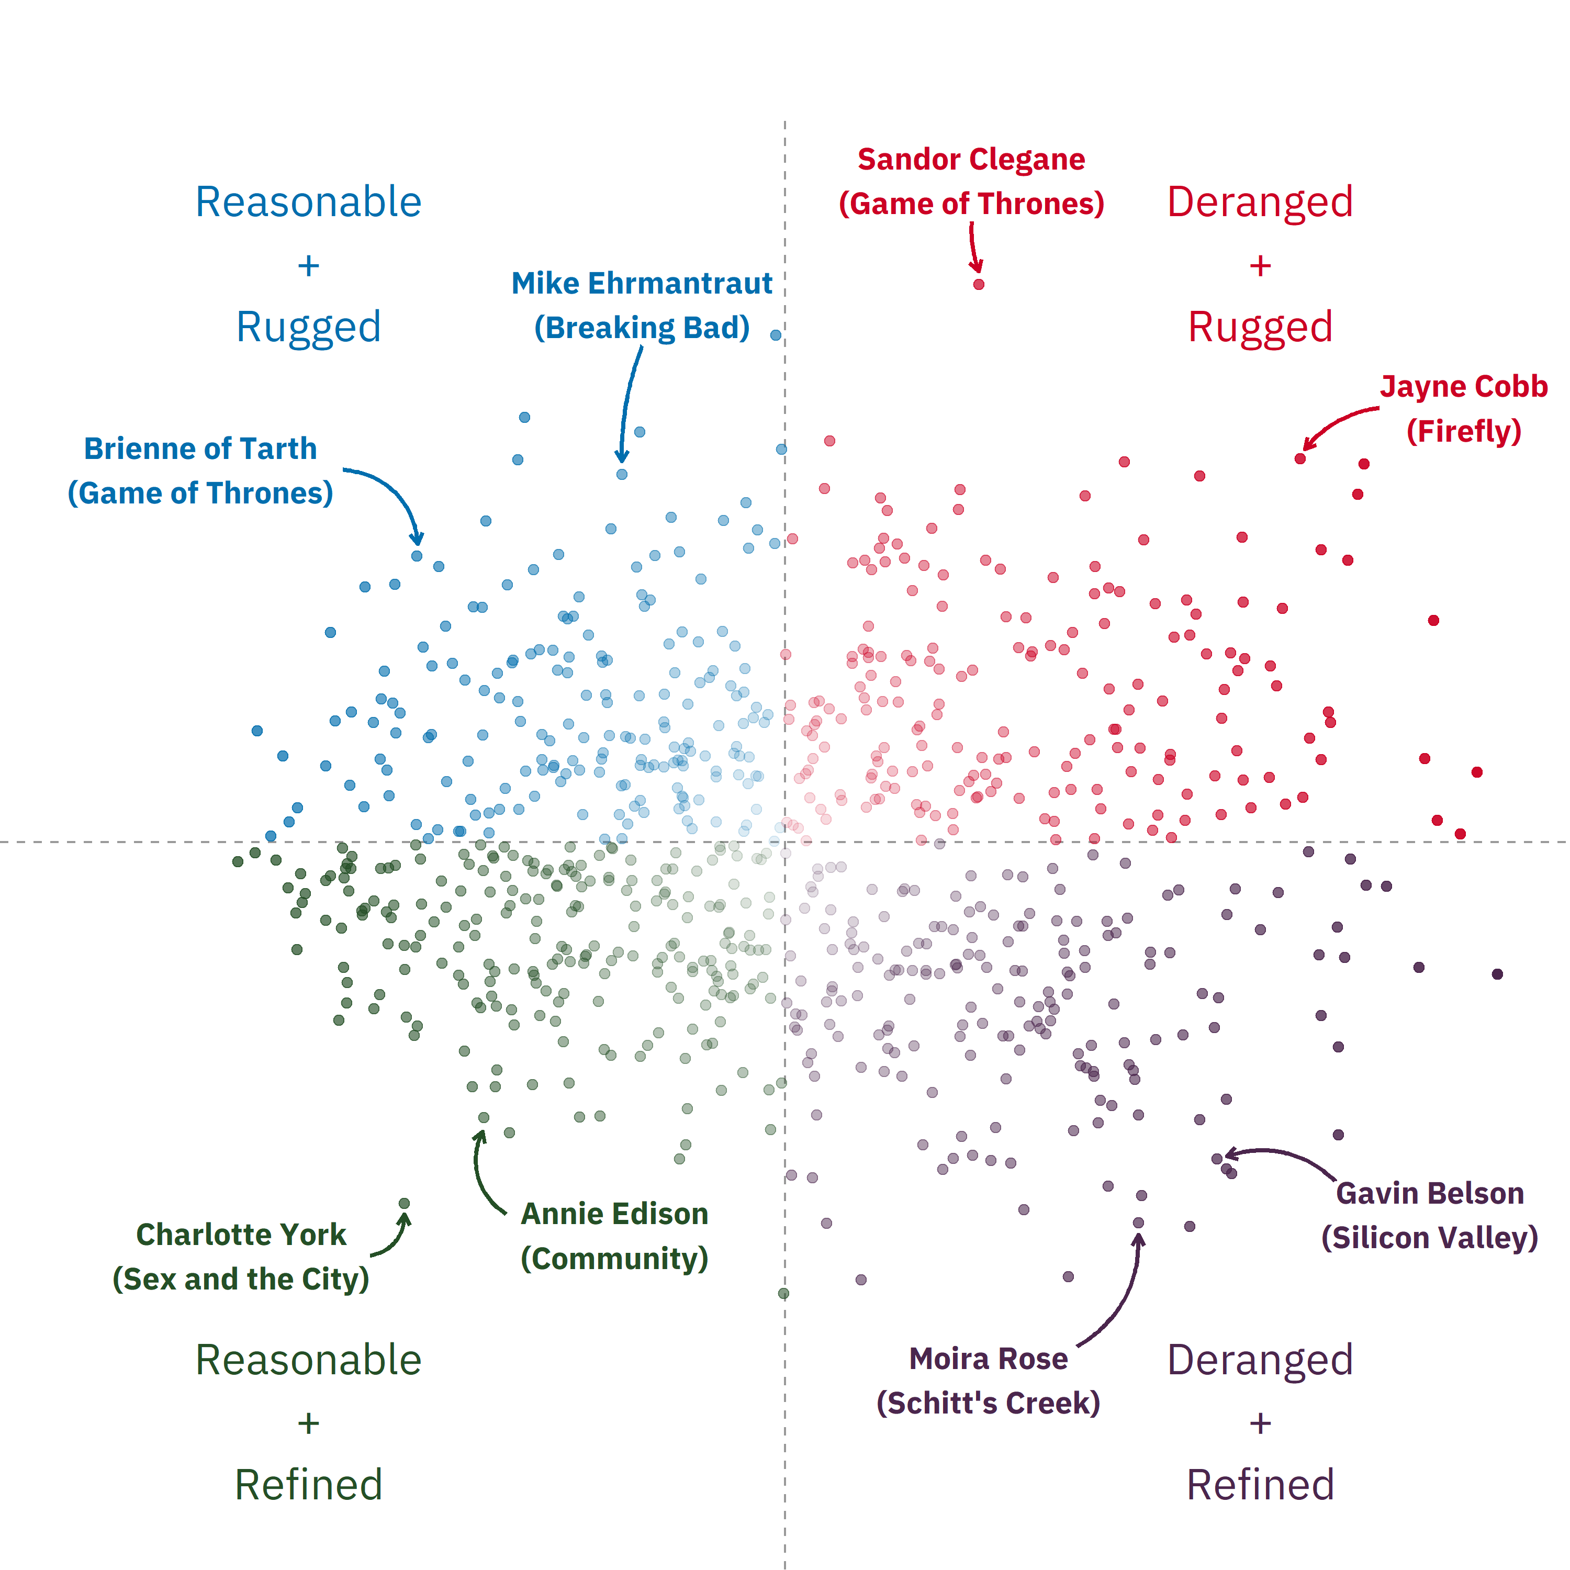

Slide 26
Conduct Principal Component Analysis (PCA) with {tidymodels}
Add text and arrow annotations
Make an interactive chart with {plotly}

Slide 27
I’ll be honest…

Slide 28
I would never put this much effort into analyzing Titanic passengers

Slide 29
Artwork by @allison_horst

Slide 30
great data
Artwork by @allison_horst

Slide 31
The Power of Great Datasets
Alex Cookson
@alexcookson
tacookson
Thank You Allison Horst for the amazing illustration

